Slide 1
Emotion Detection & Music Recommendation System
By Alwin John, Robin Roy, Devika JS,
Hemanth S, Althaf P Shanavas

Slide 2
Introduction & Motivation

Slide 3
Confused to choose a music playlist for a special occasion?

Slide 4
Music is the form of art known to have a greater connection with a person's emotion.
If a user receives a recommendation based on his preference, it will also improve his listing experience.
Developing a recommendation system could assist a user to make a decision regarding which music one should listen to helping the user to reduce their stress levels.

Slide 5





Prerequisites
Python
TensorFlow
OpenCV
Flask
Spotipy

Slide 6
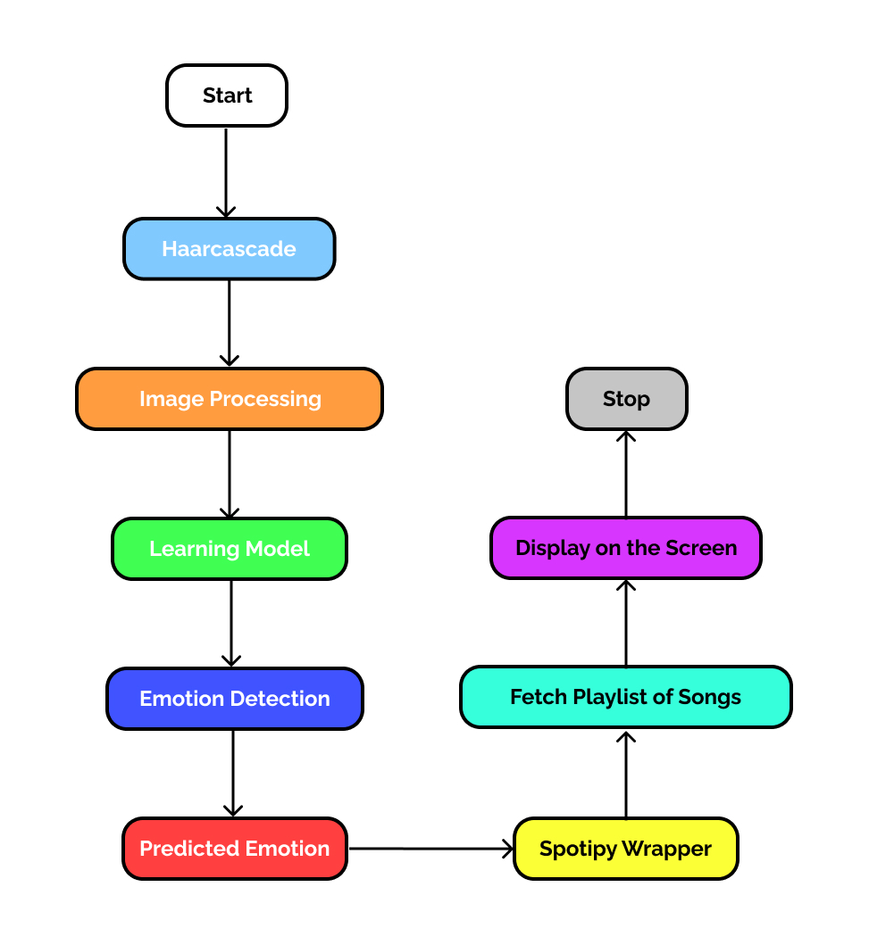
Workflow

Slide 7
Implementation

Slide 8
Spotipy will be needed for establishing a connection to and getting tracks from Spotify using Spotipy wrapper
Haarcascade OpenCV module for face detection
For video Capturing and streaming live from the webcam later processing the image, we need to use models from Tensorflow Keras in order to achieve accuracy in detection

Slide 9
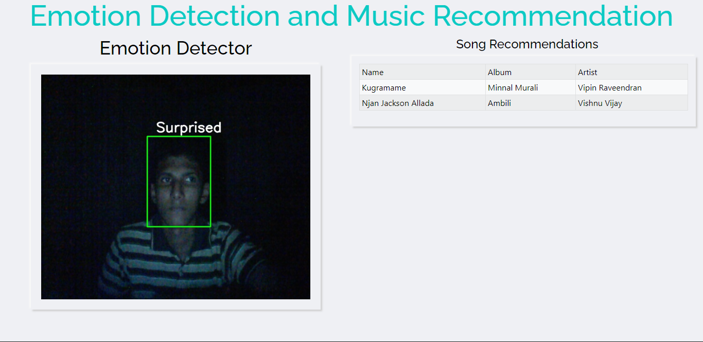

Slide 10
Flask will be the web framework to be used for to build the application
HTML and CSS will be used for structuring and styling
Utility module for video streaming of web camera with threads to enable real-time detection
Script for image processing and training the model

Slide 11
Conclusion
Developing a recommendation system could assist a user to make a decision regarding which music one should listen to helping the user to reduce his/her stress levels
We believe it will improve the approach of listening to music, that is it has got a unique ability to lift up one's mood

Slide 12
Thank You

